Slide 1
Udacity Self Driving car engineer Nanodegree Program Chapter1- Computer Vision
Udacity self driving car Engineer nanodegree program Chapter1-Computer Vision
INTRODUCTION TO Deep Learning for Computer Vision
Document prepared by - Poluri Nikhil Koundinya
INTRODUCTION TO DL USING CV

Slide 2
1- Introduction to DL for Computer Vision

Slide 3
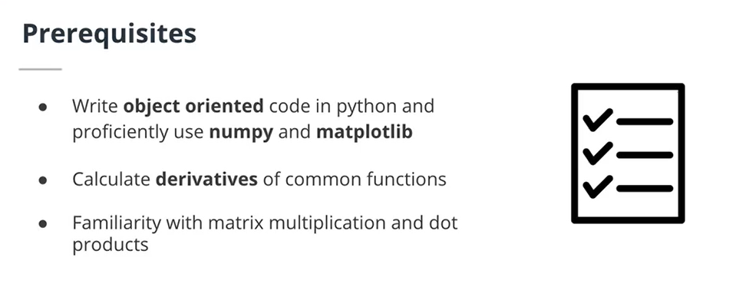

Slide 4
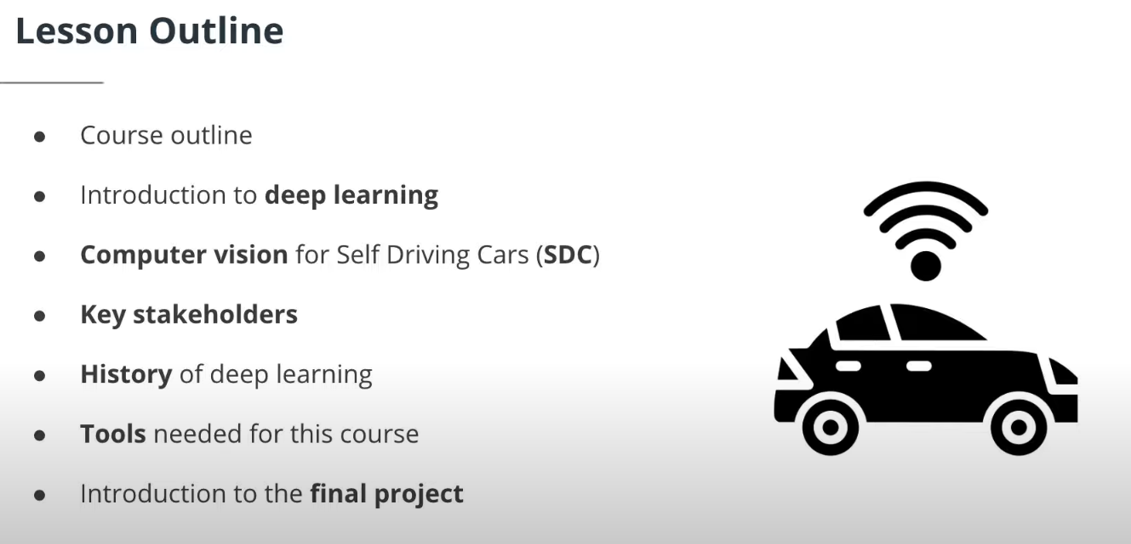
The prerequisites for this course are to be able to:
Write object oriented code in Python and proficiently use the numpy and matplotlib libraries (such as for matrix multiplication and simple plotting)
Calculate derivatives of common functions (basic calculus skills) such as x^2, 1/x
Compute multiplication of matrices and dot products (basic linear algebra skills)

Slide 5
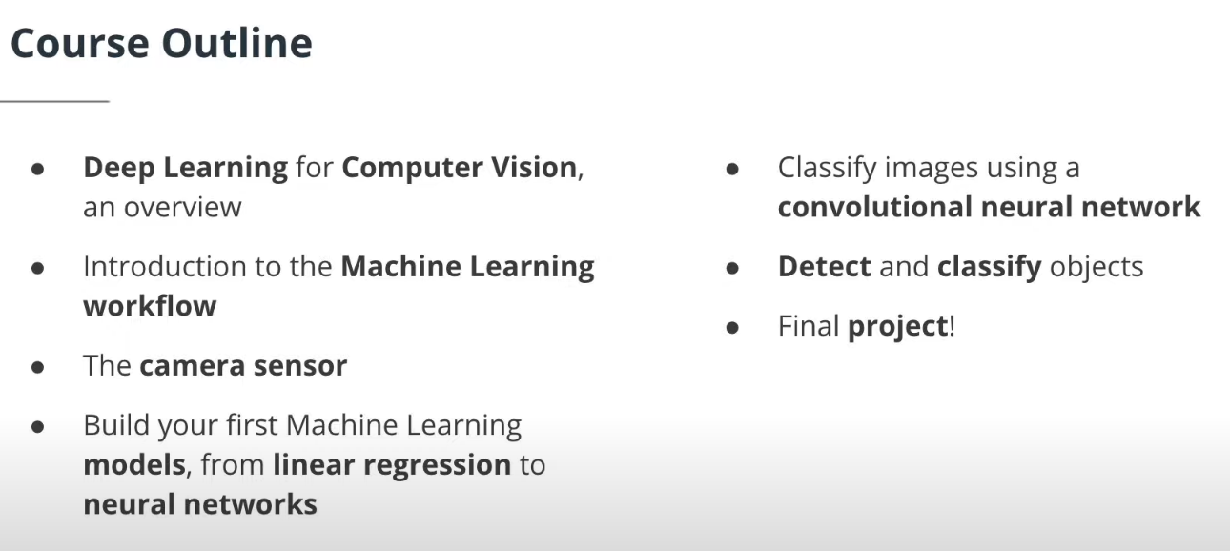

Slide 6
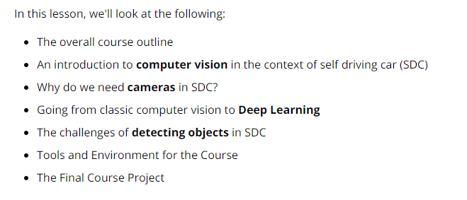
Lesson Outline

Slide 7
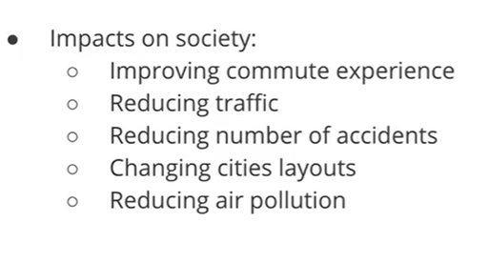
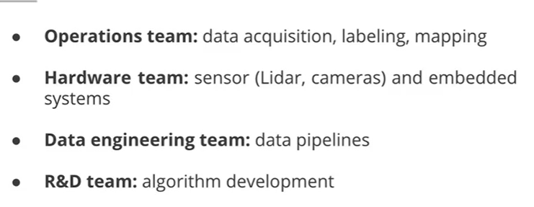
Impacts of SDC on Society and various teams involved
Key Stakeholders

Slide 8
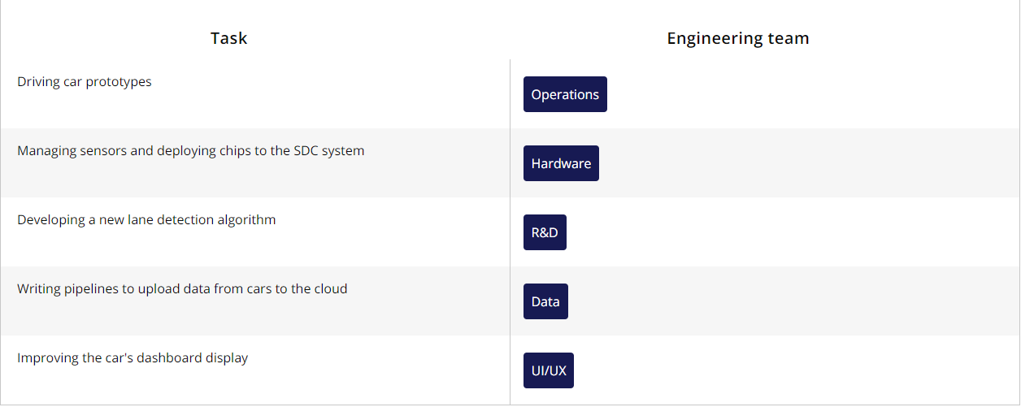
Example tasks for various Engineering teams

Slide 9
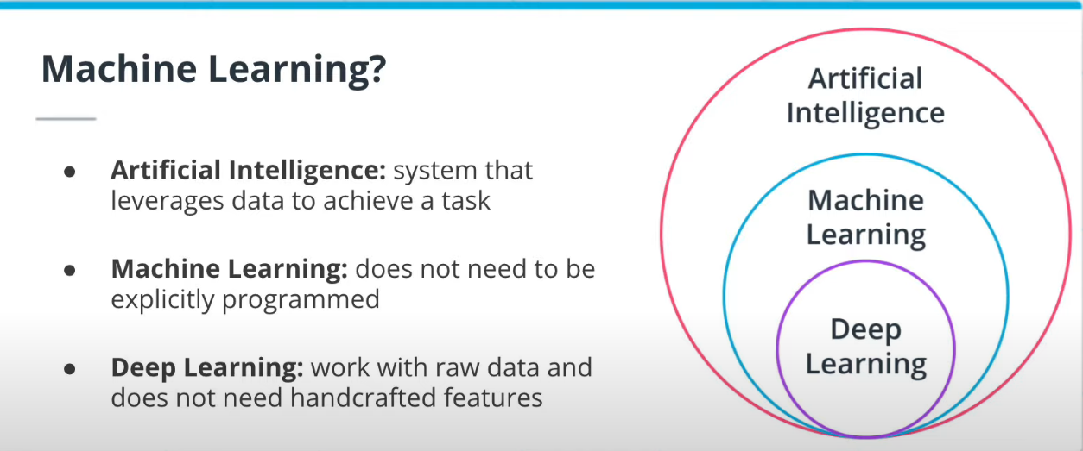

How is DL different from ML? DL can work with Raw data while in ML sometimes we have to handcraft features. we are classifying a image if it has a dog or not. In an ML approach, we build the dog features like the ear, nose detectors. Ans then we find these in the images. In DL, we give the model images directly

Slide 10
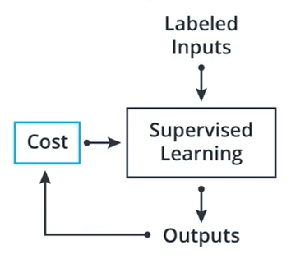
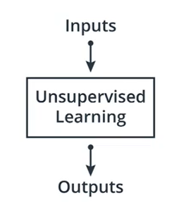
Machine Learning
Supervised Learning
Unsupervised Learning
Reinforcement Learning
Classification
Regression
Clustering

Slide 11
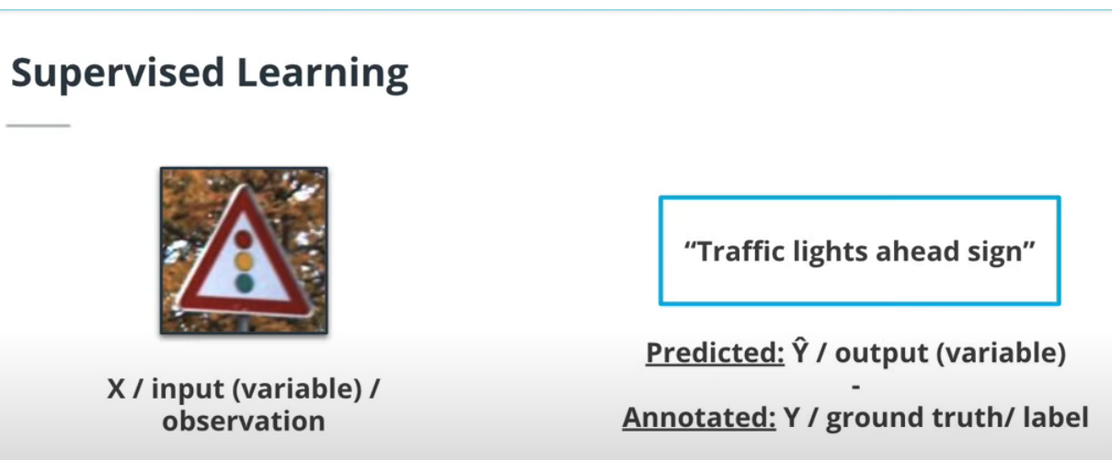
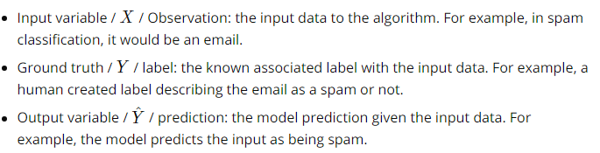
Note: In supervised learning, we require access to labelled data. The labelling task comes at a great cost. There are companies that perform only labelling task for DL teams.
These terms will be frequently encountered in ML problem.

Slide 12
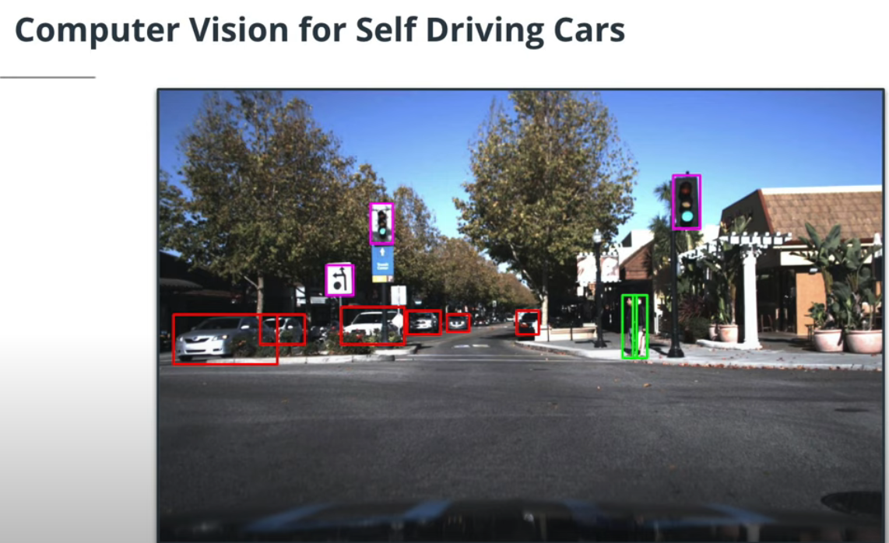
Why CV Is Important for SDC
Deep Learning algorithms are now the state of the art (SOTA) in most computer vision problems, such as image classification or object detection. Therefore, they are now in every SDC system. However, using deep learning adds additional constraints to the system because they require more computational power.
What can a CV system do in a self driving car
1- car detection
2- Traffic light and traffic sign
3- Pedestrian detection

Slide 13
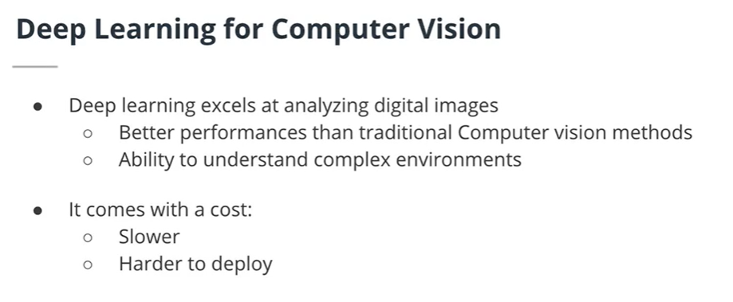
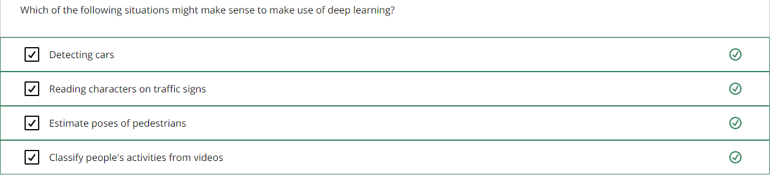

Slide 14
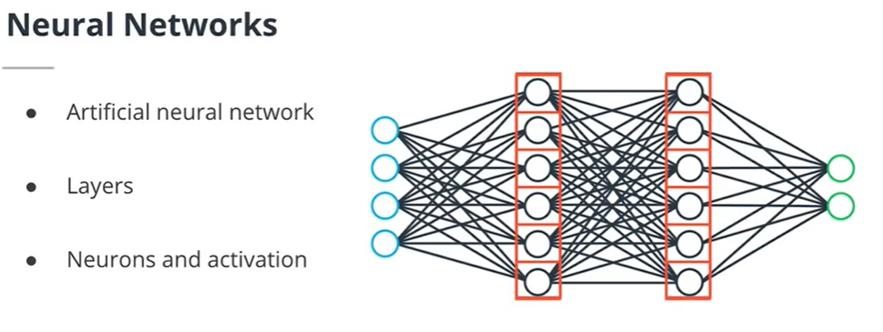
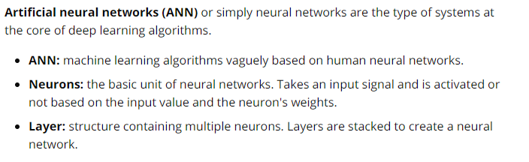
Basics and History of DL
Hidden layers
Input layers
Output layers
The term DL comes from Deep neural networks where many layers are stacked. In this figure, each neuron in a layer is connected to each neuron of the previous layer and connected to each neuron of the next layer. This is called Feed Forward Neural N/W. A neuron receives an input signal and are activated or not based on this input. We say that the neuron is firing if it is activated.

Slide 15
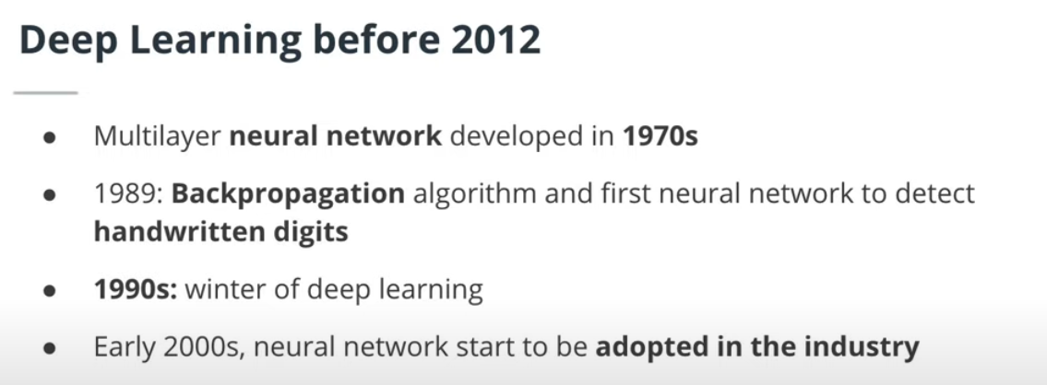

Slide 16
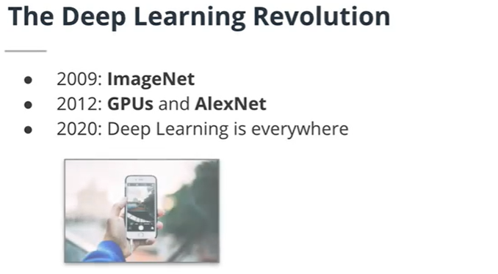
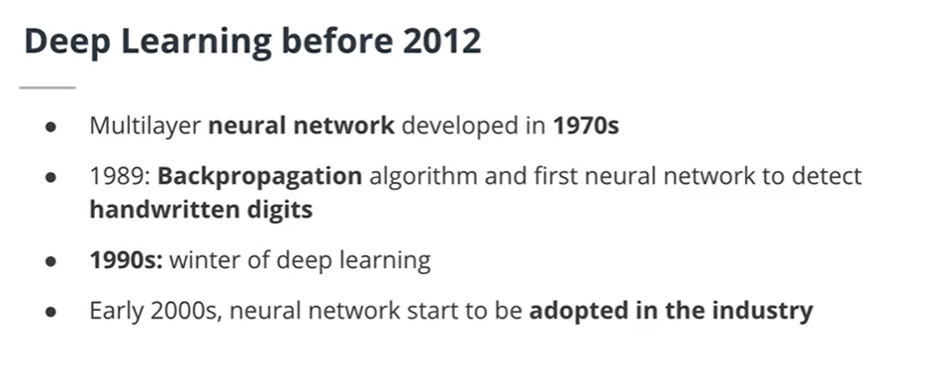

Slide 17
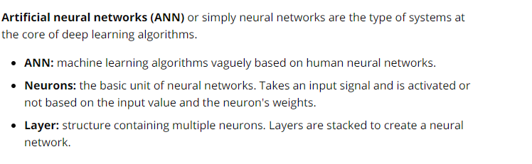
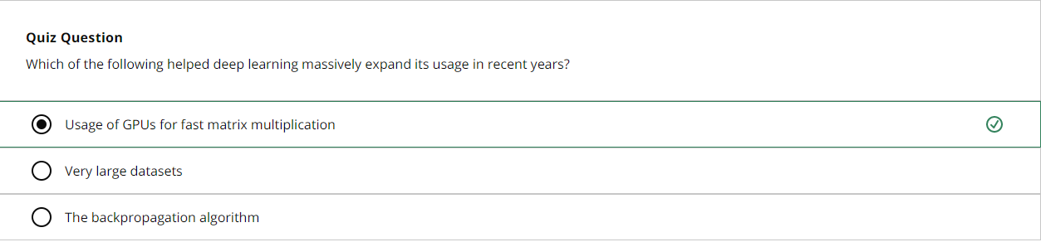

Slide 18
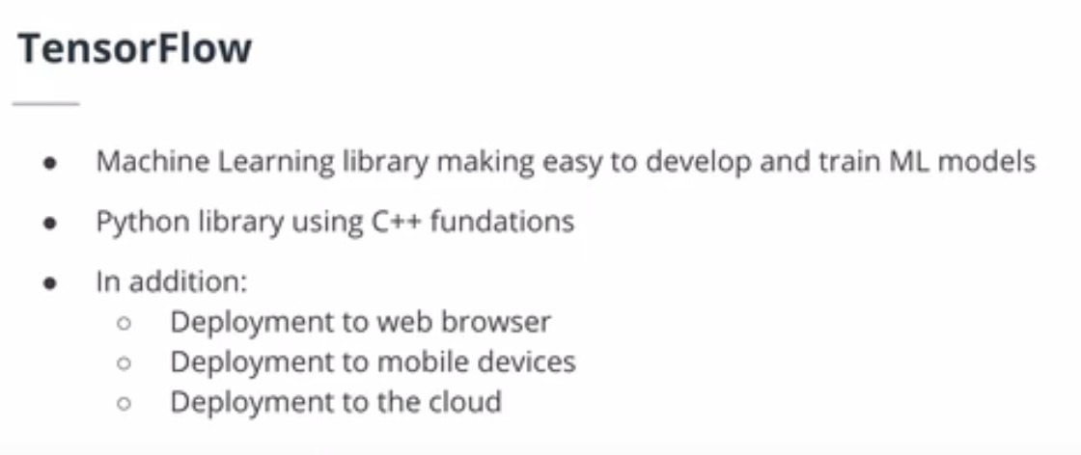
Introduction to TensorFlow

Slide 19


Tools, Environment & Dependencies

Slide 20
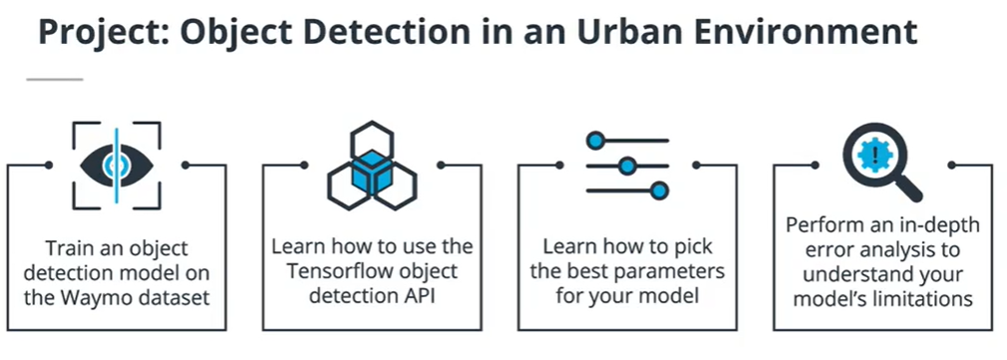
Module1 final project details
For the final project of this course, you will have to train an object detection model using the TensorFlow Object Detection API. This API simplifies the training and development of object detection models in TensorFlow. You will learn how to master it in this project. This API makes the exploration of the optimal parameters for your model extremely easy by using config files. Because you should try to create the best possible model, you will have to tweak and test different parameters. Finally, you will have to perform an in-depth error analysis.

Slide 21
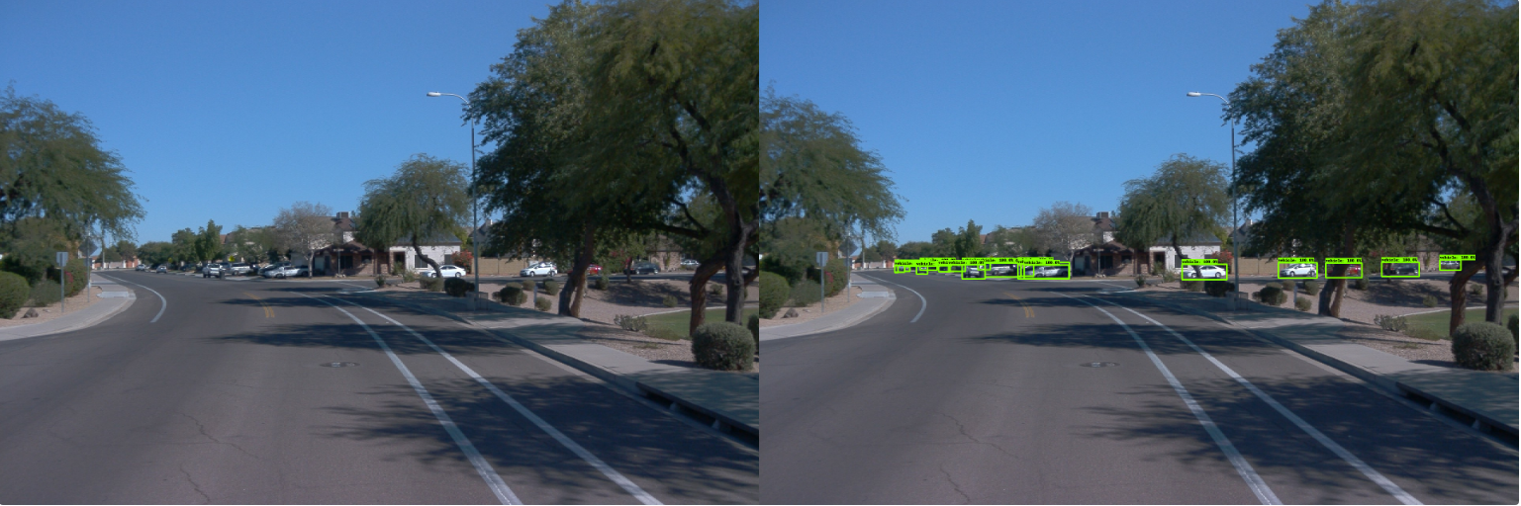

Slide 22
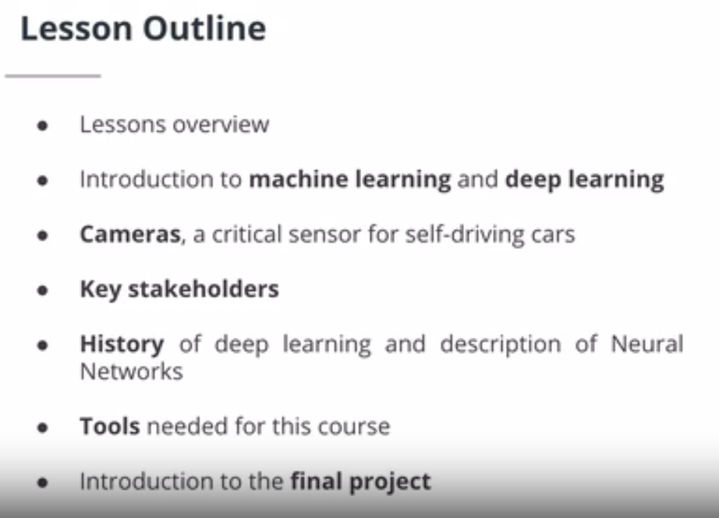

Slide 23
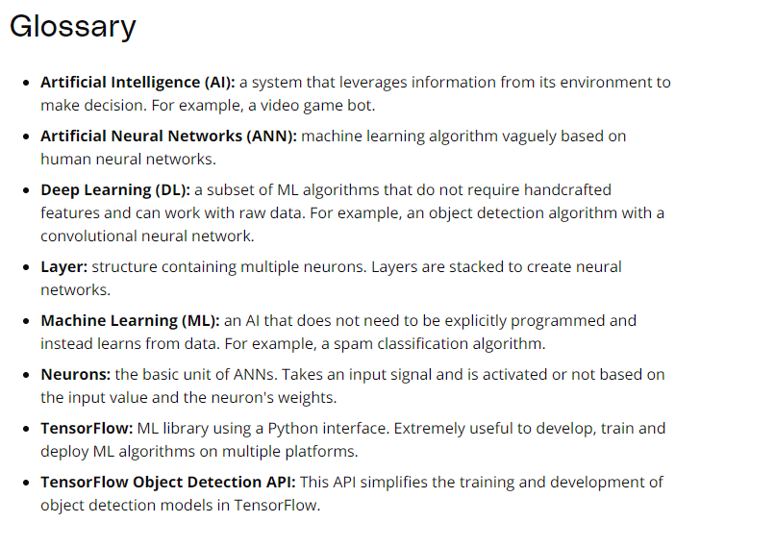

Slide 24
The End

